Slide 1
Lecture 2: Crowdsourcing: Background and Applications
Instructor: Chien-Ju Ho

Slide 2
Logistics

Slide 3
Enrollment, Piazza, and Reading Materials
Enrollment updates
Sign up for Piazza
http://piazza.com/wustl/fall2022/cse518a
Reading materials
Some papers are behind the paywall
You might need VPN to get access to some of the files when outside of WashU.
Search paper titles in search engines should also lead you to the papers.

Slide 4
Assignment 1
http://chienjuho.com/courses/cse518a/assignment1.pdf
Submit via Gradescope
You should have already been added to the rosters on Gradescope
Due date:
September 16 (Friday)
Do 3 tasks AND earn $0.25 as a crowd worker
MTurk is recommended
If you are denied registration for a new MTurk account, you can
Borrow accounts from your friends/classmates
Use other crowdsourcing platforms

Slide 5
Requirements of Assignment 1
Proof that you have done it
Estimate hourly wage
How should the requester improve?
How should the platform improve?
Getting a worker account is probably the most challenging part of this assignment.
Please start early. Let me know if there are any issues.
There will be no extensions if the issues are brought up right before the deadline.

Slide 6
Logistics: Prerequisites
Need to be comfortable with several math concepts and basic programming
Probability
linear algebra
calculus
basic concepts about computer science and ability to program
If you are not sure, please take a peek at the papers from Sep 8 - 29
You should at least be able to understand the formulation and main results
You will need to implement some algorithms in these papers

Slide 7
Logistics: Reviews
Reviews grading
We are expecting a paragraph response (a few sentences) for each question.
You can assume you get full points if not notified by me within 2 weeks of submission.
Typical reviews involve 4 questions
Summarize the paper in a few sentences
List 2~3 points you like/dislike about the paper
Two paper-specific questions
Use Gradescope for review submissions

Slide 8
Logistics: Presentations and Leading of Discussion
You need to present papers and lead discussions as a group
Need to do it once this semester
The target number of groups is 11~13
The size of the group depends on the final class size
most likely 3~4 students per group
Talk to me a week before the lecture
Strongly encouraged to include discussions in class
More details will be announced next week

Slide 9
Logistics: Course Projects
Project proposal (Tentative Due: Sep 23)
The project should be explicit human components, and it can be theoretical, empirical, application, or literature survey.
I’ll make the final call on whether it’s relevant to the course and might suggest modifications.
How to choose topics
I’ll generate a list of potential/past projects
Look at future lectures to see what topics you might be excited about.
Feel free to schedule appointments with me to discuss your course projects.

Slide 10
Lecture Today

Slide 11
How many circles are in the image?
Input your guess: https://ppt.cc/fW5hfx
Reward:
Two more late-days for the assignments for the one providing the closet guess
Notes:
721

Slide 12
“The Dot Guessing Game: A Fruit Fly For Human Computation,” Horton. 2010
Notes:
$5 for top half. $0 otherwise
$2.5 flat

Slide 13

The Wisdom of Crowds
At a 1906 country fair, ~800 people participate in a contest to guess the weight of an ox.
Reward is given to the person with the closest guess.
The average guess is 1,197lbs. The true answer is 1,198lbs.

Slide 14
When is the Crowd Wise?

Slide 15
Discussion
Under what conditions is the crowd wise?
How should we (mathematically) model the crowdsourcing process?
How to combine the results?
Can we estimate how accurate the combined result is?
Can we better design the process to motivate higher-quality data?
…
Notes about the discussion
Please spend a minute introducing yourselves to others!
Be prepared to share what you have discussed. We will ask volunteers and also randomly pick people to share.

Slide 16
When is the Crowd Wise?
Some general “beliefs” for the crowd to be wise
Informed individuals
Diversity of opinions
Independence
Good aggregation
Aligned incentives
…
Can we make these ideas more formal?
Can we “model” the process?

Slide 18
Example Model on Aggregation
People have unbiased estimates of the true answer
user guess = true answer + Gaussian noise
What can we do with this model?
Assume the model somewhat captures the reality,
we can infer the true answers from the user guesses we observe (mean is a good estimate)
we can further analyze the ”number of guesses” we need to achieve certain accuracy
Does this model capture the reality?
what if everyone has different abilities in guessing? How do we perform inference?
what if there are some unknown biases?
Observations
Latent values we want to know
Zero-Mean Noises

Slide 20
Example Model on Incentives
People choose effort level in generating their true answer
user-answer = true-answer + noise(effort)
user utility = reward * Pr(getting reward | effort) – cost(effort)
user chooses effort that maximizes their utility
What can we do with the models
Designing the optimal incentive schemes
How much we should pay, should we offer a bonus?
What to design non-financial incentives (badges, leaderboards, etc).

Slide 22
The Focus of this Course
Design and analysis of human-in-the-loop computation
Develop “models” of how humans take actions in our systems
Based on the model,
design methods to aggregate user information
design incentives to encourage high effort and truthful reports
Deal with practical challenges (complex tasks)
Discussion on selected recent topics on human-AI interactions

Slide 23
The Focus of this Course
Design and analysis of human-in-the-loop computation
Deal with practical challenges (complex tasks)
New Programming Paradigm
New way to organize teamwork

Slide 24
The Focus of this Course
Design and analysis of human-in-the-loop computation
Discussion on selected recent topics on human-AI interactions
Ethical decision making
Fairness and privacy in AI/ML
Interpretable machine learning
Strategic machine learning
Human-AI teaming

Slide 25
The Wisdom of Crowds
At a 1906 country fair, ~800 people participate in a contest to guess the weight of an ox.
Reward is given to the person with the closest guess.
The average guess is 1,197lbs. The true answer is 1,198lbs.
It’s hard to bring together a large crowd in the old times.

Slide 26

Time Person of the Year 2006
>4 Billion Internet users worldwide as of 2018!
21% of Americans go online almost constantly!

Slide 27
















The Internet Age and the Rise of Crowdsourcing
Connect
Create
Share
Collaborate

Slide 28
Let’s look at a few more applications

Slide 29


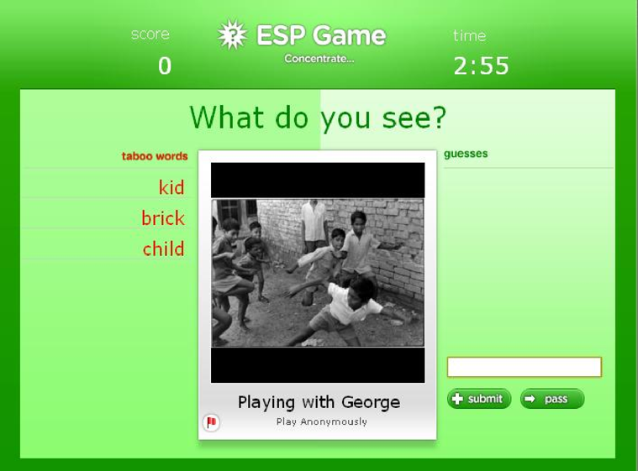
Games with a Purpose
ESP Game: Crowdsource image labeling via games
boy
white
black
window
wall
…
playground
children
running
boy
…
Potential Label: Boy
von Ahn and Dabbish. Labeling Images with a Computer Game. CHI'04

Slide 30
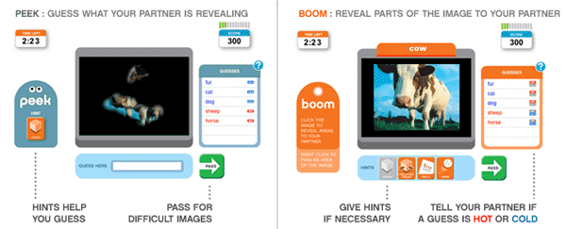
Games with a Purpose
Peekaboom: Crowdsource image segmentation via games
von Ahn et al. Peekaboom: A game for locating objects in images. CHI’06

Slide 31
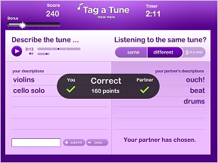
Games with a Purpose
TagATune: Crowdsource audio annotation via games
Law et al. TagATune: A Game for Music and Sound Annotation. ISMIR’07

Slide 32
Design and Analysis of Game with a Purpose?
How to ensure the data quality is high?

Slide 33
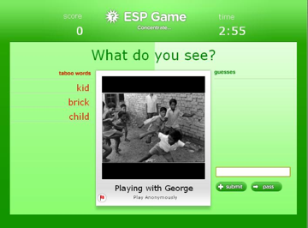
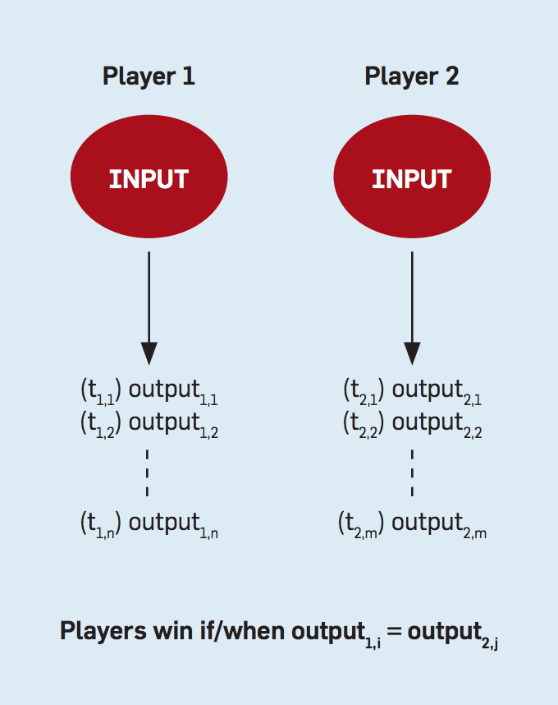
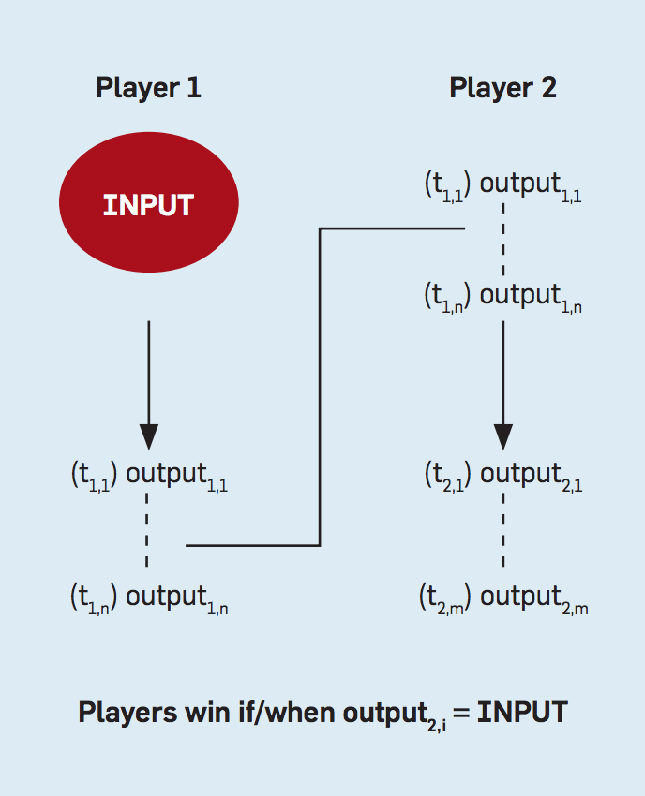
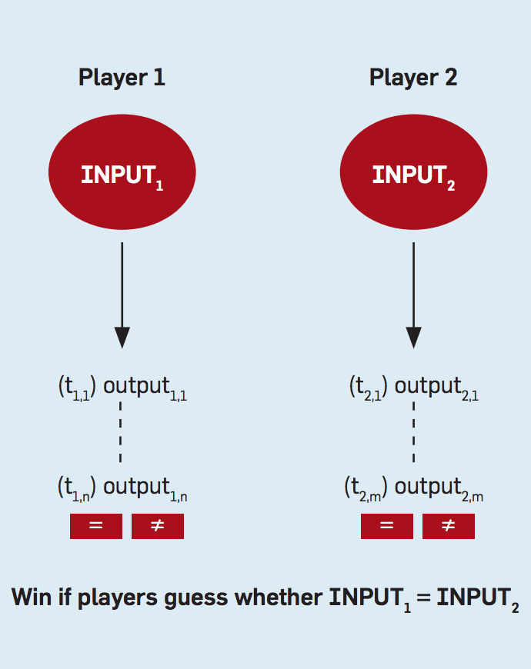
Output Agreement
Inversion Problem
Input Agreement
von Ahn and Dabbish. Designing Games with a Purpose. Comm of ACM, August 2008

Slide 34

Another way to come up project ideas:
Try to improve existing systems or fix potential issues.
What can we do to ”improve” ESP Game? Are there any issues with ESP Game?
People are competitive.
Potential issues of ESP Game
Coalition Problem: let’s type “a” for all images
Easy words first…
Biased by the list of taboo words
Microsoft implemented a bot
analyzes taboo words only
achieves match with humans with >80% chance

Slide 35
An example research project (by myself, 10 years ago…)
Goal:
Fix the “easy-word-first” issue without using the taboo words
Incorporate some competitive elements

Slide 36

Player 2
Player 1
DOG FLOWER FLOOR
CUTE WOOD DOG

Slide 37

Player 2
Player 1
DOG FLOWER FLOOR
CUTE WOOD DOG
CONNECT WITH EACH OTHER BY TYPING THE SAME WORD

Slide 38
Couple
Couple
DOG FLOWER FLOOR
CUTE WOOD DOG
CONNECT WITH EACH OTHER BY TYPING THE SAME WORD

Slide 39
Blocker
Couple
Couple
DOG WHITE
DOG FLOWER FLOOR
CUTE WOOD DOG

Slide 40
Blocker
Couple
Couple
DOG WHITE
DOG FLOWER FLOOR
CUTE WOOD DOG
KissKissBan
A Competitive Human Computation Game for Image Annotation

Slide 41
Blocker
Couple
Couple
DOG WHITE
CUTE WOOD FLOWER
-5s game time
DOG FLOWER FLOOR
Blocked
The blocked words
-5s game time
1. First, the blocker has 7 seconds to type words 2.Then, the couples has 30 seconds to type words

Slide 42
Blocker
Couple
Couple
DOG WHITE
CUTE WOOD FLOWER
DOG FLOWER FLOOR
Couples win for matching within time limit
1. First, the blocker has 7 seconds to type words 2.Then, the couples has 30 seconds to type words

Slide 43
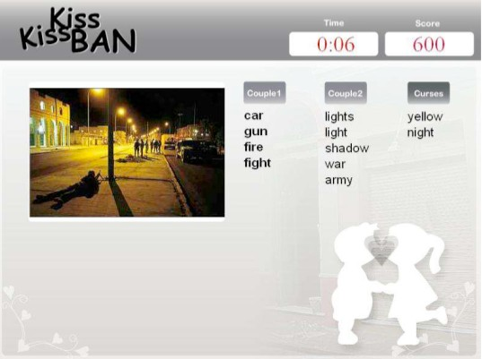
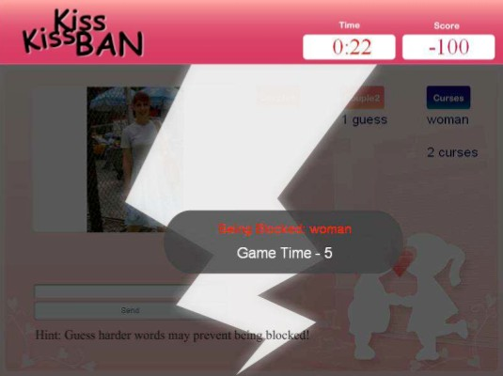
Screenshots of KissKissBan

Slide 44

Example of Collected Data
ESP | ML-KKB | BL-KKB
man 21 beach 10 karate 5 water 1 | beach 3 water 3 sand 3 sea 2 ninja 1 kungfu 1 ocean 1 | sea 9 man 8 ocean 3 black 1 china 1 sand 1
ML-KKB: matching between couples
BL-KKB: matching between couple and blocker

Slide 45
Prediction Markets
Potential payoff is $10.
If I think the probability of Romney winning is p, I should
Buy this security at any prices less than $10 p
Sell this security at any prices greater than $10 p
Price measures the population’s collective beliefs

Slide 46
Does the price converge to the collective beliefs?
Imagine the scenario:
Alice
believes the event won’t happen (p=0)
very stubborn
very rich with unlimited amount of money
Bob
believes the event will definitely happen (p=1)
very stubborn
very rich with unlimited amount of money
The price will just fluctuate between the two extremes

Slide 47
So how good are the predictions?
In practice…
Election markets beat data from polls (BR02)
Oscar markets beat expert columnists (PGN01)
HP internal markets beat sales forecasts (P00)
Racetrack odds beat experts (F79)
and many more
In theory…
Under certain assumptions, prices converge and reflect the traders’ collective knowledge
Proposing human behavior models to explain the real-world behavior

Slide 48
Crowdsourcing Markets
The Turk – Automatic Chess Player built in the 18th century

Slide 49
Crowdsourcing Markets
The Turk – Automatic Chess Player built in the 18th century

Slide 50
Crowdsourcing Markets
Amazon Mechanical Turk - Artificial Artificial Intelligence

Slide 51
Crowdsourcing Markets
A general-purpose platform for all kinds of applications
Mainly used to engage a crowd, and you can build you applications on top of it
In addition, it’s easier to design “payment” than to design “fun”

Slide 52
There are more….

Slide 53
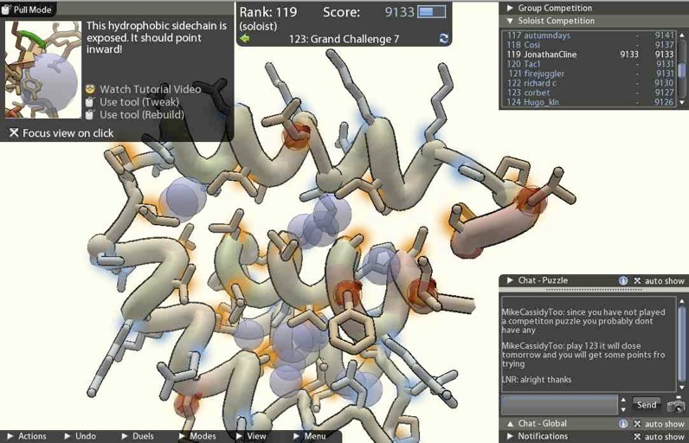

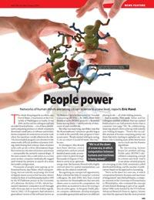
Citizen Science Projects
FoldIt: Online video game for protein folding
2011: decipher the crystal structure of an AIDS-related virus
2012: The first crowdsourced redesign of a protein
Cooper et al. Predicting Protein Structures with a Multiplayer Online Game. Nature, August 2010
Notes:
In 2011, Foldit players helped decipher the crystal structure of the Mason-Pfizer monkey virus (M-PMV) retroviral protease, a monkey virus which causes human immunodeficiency virus infection and acquired immune deficiency syndrome (HIV/AIDS), a scientific problem that had been unsolved for 15 years. While the puzzle was available for three weeks, players produced an accurate 3D model of the enzyme in only ten days.^{[13][14]}
In January 2012, Scientific American reported that Foldit gamers achieved the first crowdsourced redesign of a protein,^{[11]} an enzyme that catalysed the Diels–Alder reactions widely used in synthetic chemistry.

Slide 54
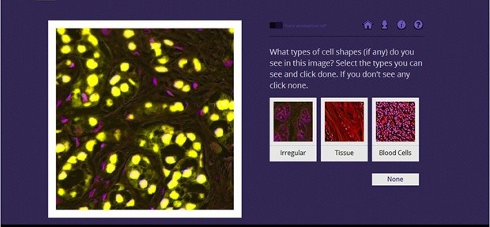
Citizen Science Projects
Cell Slider: Examine tumor tissue samples and spotting cancerous cells
Notes:
Three years ago we launched the Cell Slider project. And like a scientific version of spot the difference, members of the public were asked to identify breast cancer cells and gauge how brightly they were coloured by looking at images on the project’s website.
98,293 Citizen Scientists took up the challenge. And now the results are in.
It turns out that they did a pretty good job of spotting the cancer cells. In fact, when the data were averaged across all those who took part, the combined analysis from the volunteers was almost as accurate as a trained pathologist.

Slide 55
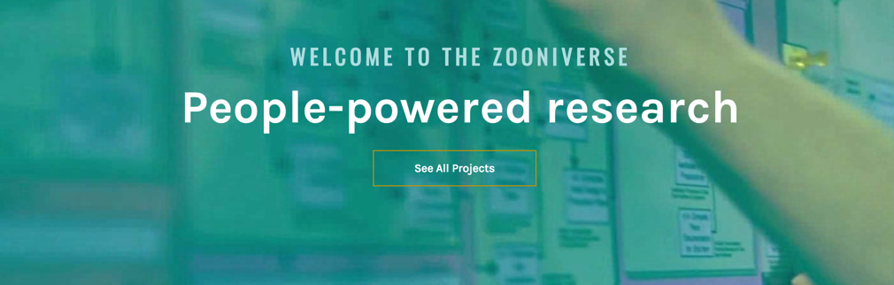

Citizen Science Projects
Zooniverse: A citizen science web portal

Slide 56
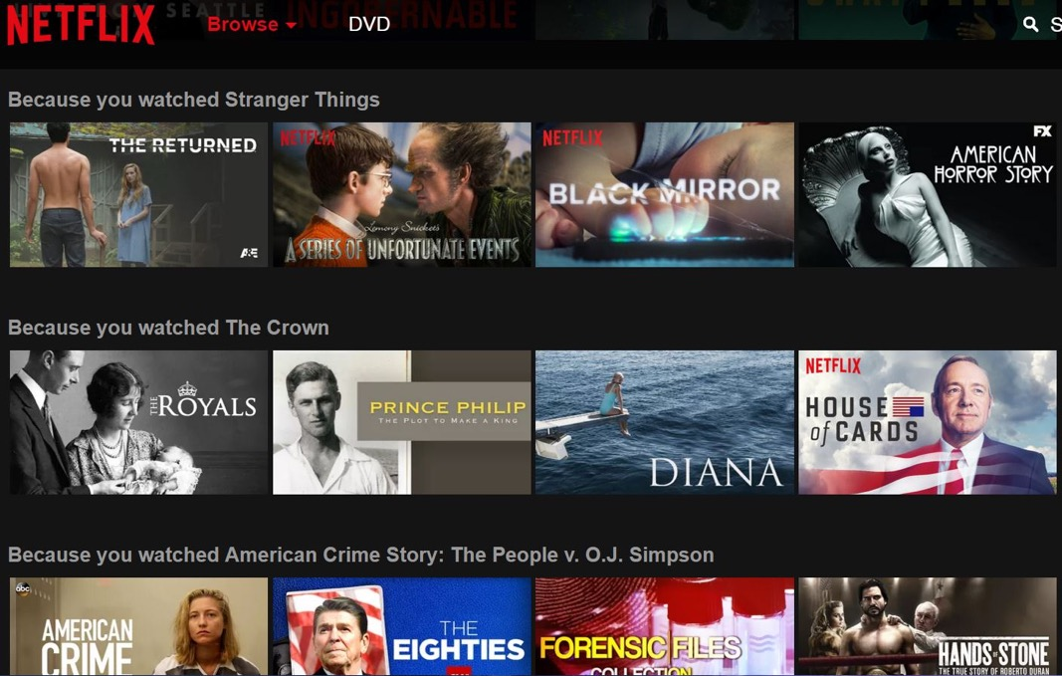
Crowdsourcing Contests
Netflix Prize, 2006
44,014 submissions
The best solution improve its recommendation engine’s performance by 10%
crowdsourcing within a crowdsourcing competition
Notes:
internet entertainment service
US$1,000,000
The competition began on October 2, 2006. By October 8, a team called WXYZConsulting had already beaten Cinematch's results

Slide 57
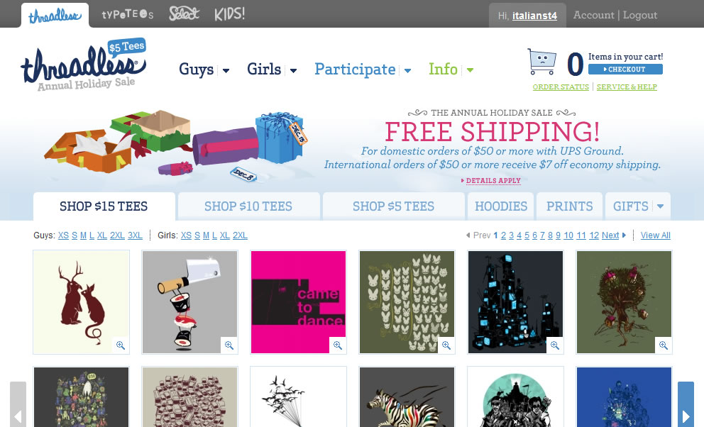
Crowdsourcing Contests
Threadless
Crowds generate the design
Crowds vote on the design
438,451 designs submitted, 8,805 printed
Notes:
is an online community of artists and an e-commerce website
like t-shirts, V-necks, & sweatshirts, accessories from mugs to phone cases, and home decor from art prints to throw pillows

Slide 58
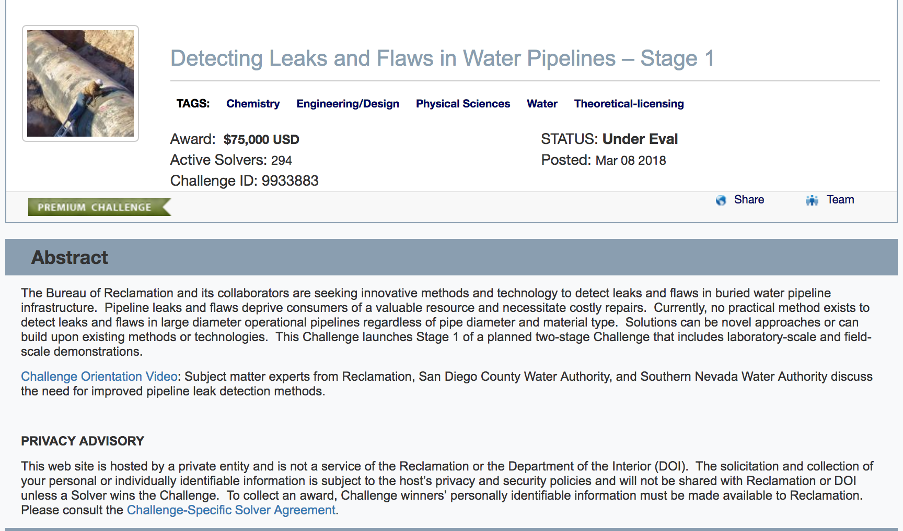
Crowdsourcing Contests
InnoCentive
Crowdsourcing problem-solving
2000+ problems, 380,000+ solvers
Problems are supplied by corporations, governments, non-profits, etc.

Slide 59

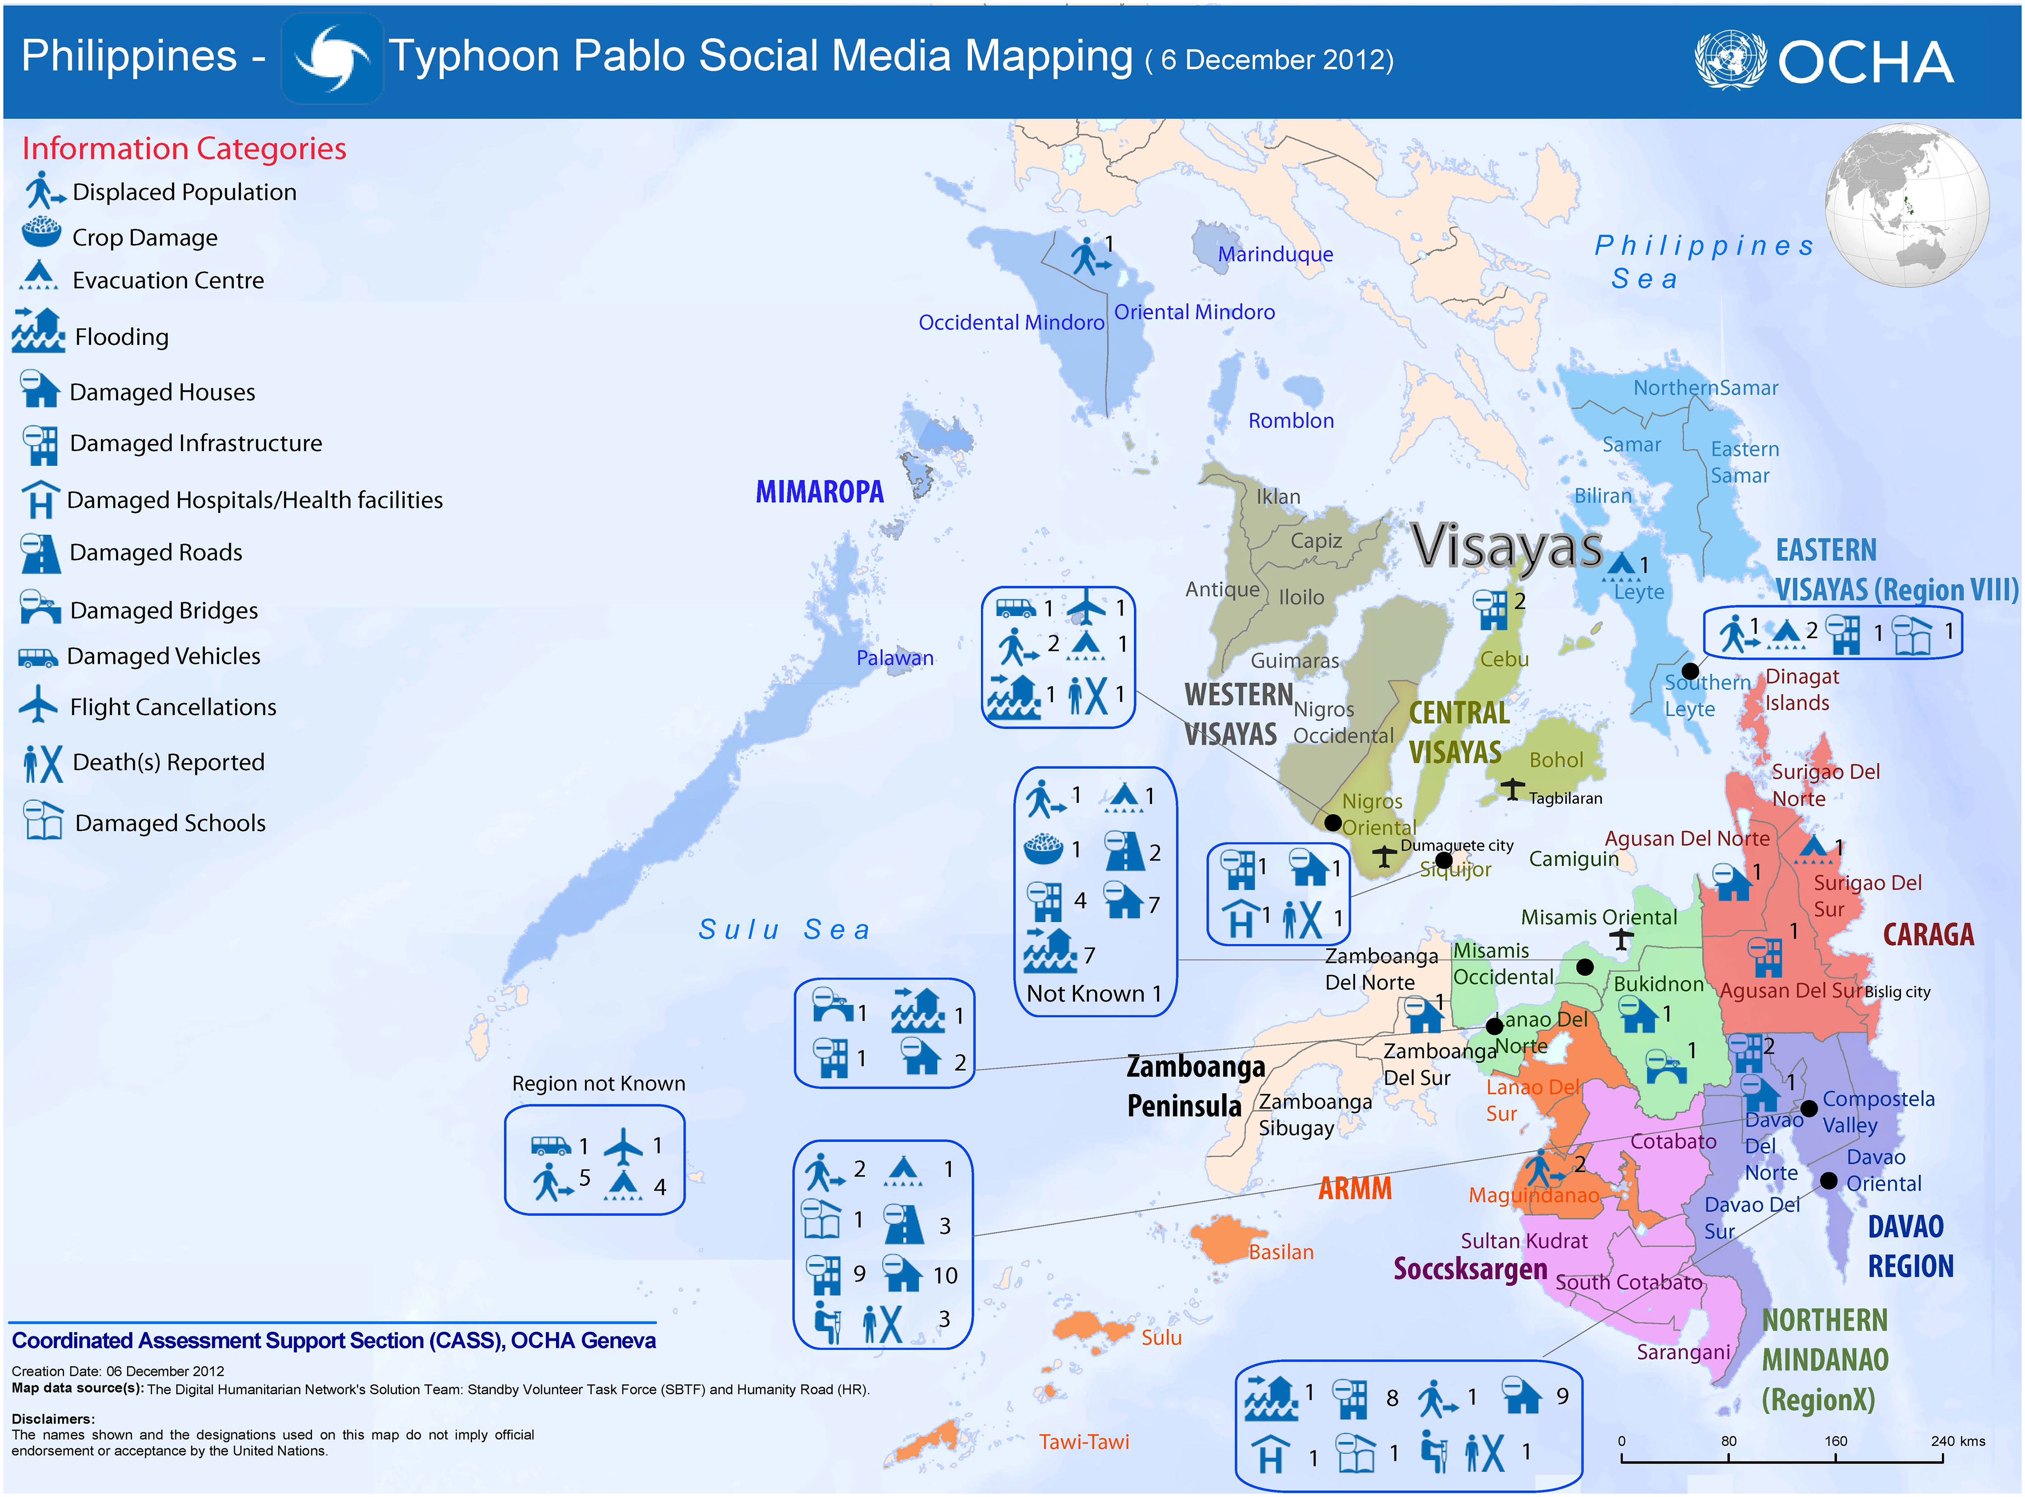
Crisis Mapping
Engage a crowd to gather and analyze the data in real-time when a crisis happens

Slide 60
Collective Research: Polymath Project
Collaborative Math Problem Solving
Published papers under the pseudonym D.H.J. Polymath.
Majority of contributions are done by a few
Timothy Gowers (Cambridge)
Terence Tao (UCLA)
Many have made solid contributions
The Polymath Project: Lessons from a Successful Online Collaboration in Mathematics. Cranshaw and Kittur. CHI'11

Slide 61
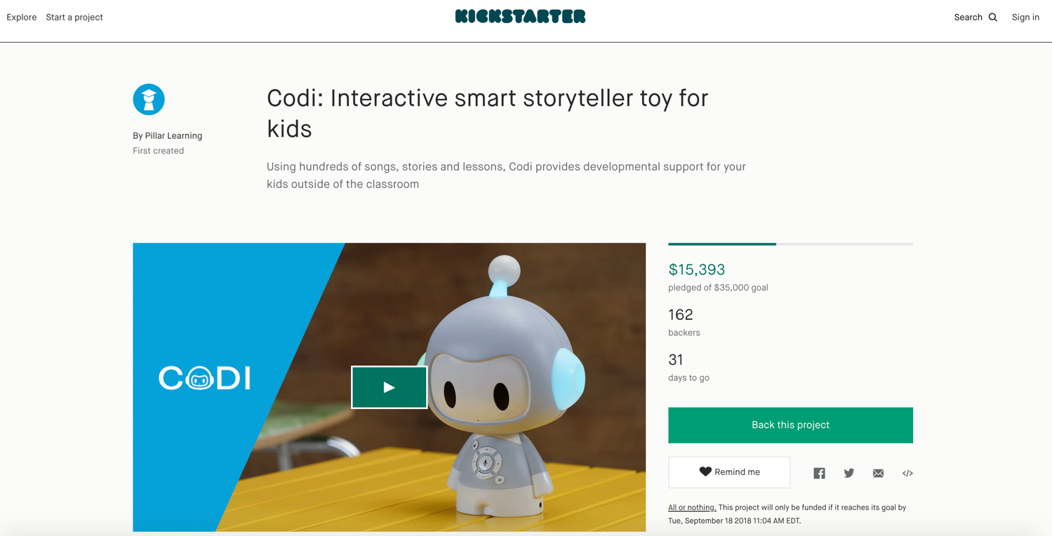
Crowdfunding

Slide 62

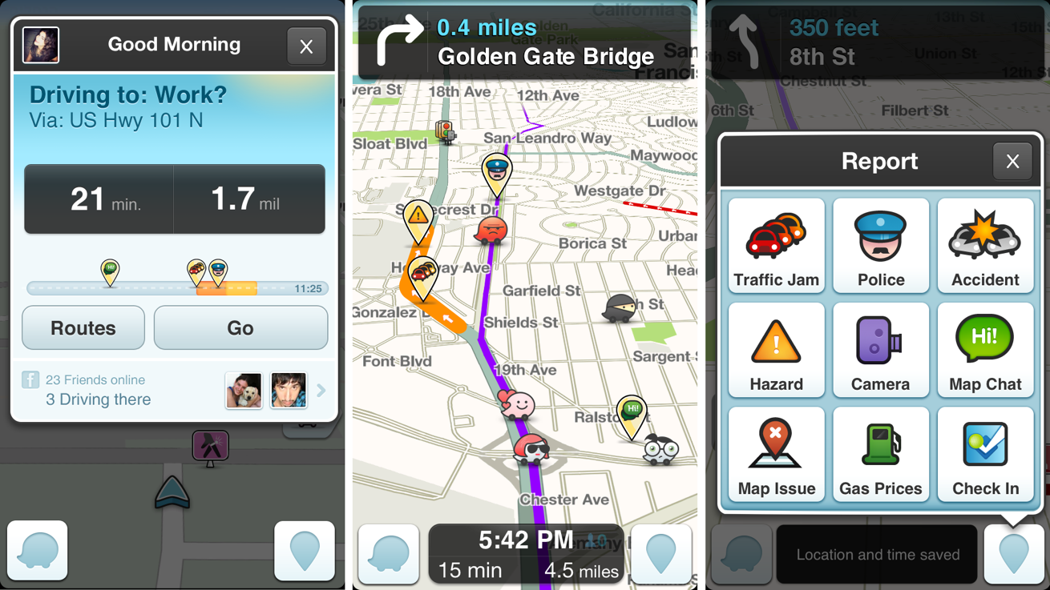
Crowdsensing: Waze
Notes:
One of the unique aspects of Waze is the ability to direct users based on crowdsourced information. Waze users are able to report a multitude of traffic-related incidents from accidents to police traps. This data is used by Waze to help other users either by alerting them of the condition ahead or even rerouting the user to avoid the area entirely. In addition to user input, Waze also relies on information from state agencies for traffic events such as road construction. The idea behind this is, the more people who provide data the more accurate it will be.^{[58]}
In addition to using crowdsourced information for traffic alerts, Waze also allows registered users to modify the map data itself through the Waze Map Editor. Map editors are allowed to make changes to the map based on where they have driven while using Waze as well as their rank which is based on how many map edits a user has made.

Slide 63

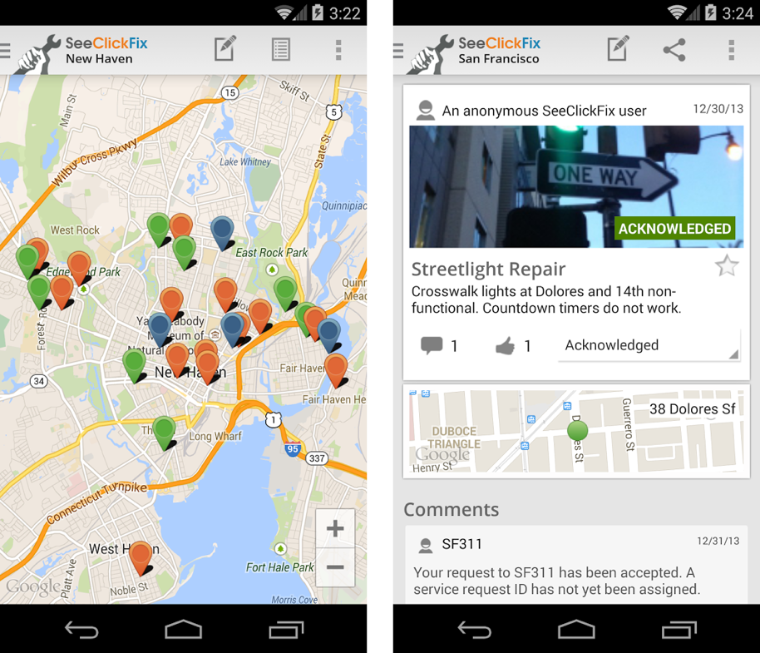
Crowdsourcing: SeeClickFix
Notes:
SeeClickFix publishes a web tool which allows people to report non-emergency neighborhood issues to local governmentbodies. The tool has a free mobile app that maps user comments. Users may add comments, suggest courses of action, or add video and picture documentation. Users can receive notifications based on selected areas and keywords. The tool is also used by 300 cities which pay the company for request management and back office work order services. 180 city halls publish white-labeled SeeClickFix app. Examples include Houston, Texas, and Detroit, Michigan.^{[citation needed]}

Slide 64
Discussion
What are some other examples of crowdsourcing applications?
What are some examples of challenging tasks in your daily life? Can you utilize the idea of crowdsourcing to help with your challenging tasks? Why or why not?

Slide 65
Next few lectures
Label aggregation
Use probabilistic inferences to aggregate noisy data generated by humans
Incentive design
Model user incentives and discuss the design to motivate high-quality data
Will be the more mathematical lectures of this semester

